Slide 1
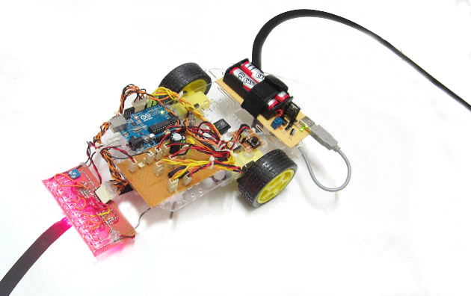
A project report on Line follower robot
LINE FOLLOWER ROBOT
SUBMITTED BY
Bishwanath Sarker
ID:13141203032
Intake: 16th
B.Sc. Engg. in CSE
BUBT

Slide 2
CONTENTS
OBJECTIVE
COMPONENTS REQUIRED
PRINCIPLE
BLOCK DIAGRAM
COADING
LINE-FOLLOWER CONCEPT
APPLICATIONS OF LINE FOLLOWER

Slide 3
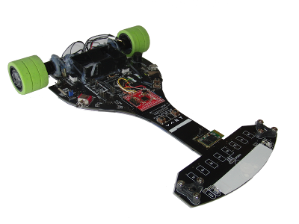
To design a line follower robot using Arduino Uno Microcontroller
OBJECTIVE
OBJECTIVES:

Slide 4
01. Chassis 02. Motors 150 RPM x 2 03. Wheels x 2 04. Arduino UNO R3 05. Motor Driver IC L298N 06. IR sensor x 2 07. Mini Breadboard 08. 9 volts Battery and stripper 09. DC jack 10. Wires
MATERIALS
COMPONENTS REQUIRED

Slide 5
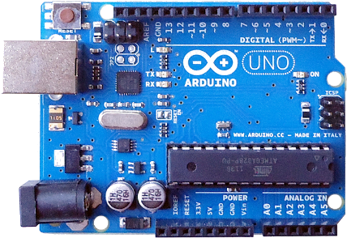
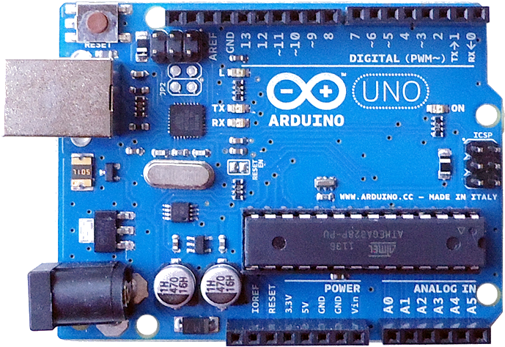
Arduino is a tool for making computers that can sense and control more of the physical world than a desktop computer. It's an open source physical computing platform based on a simple microcontroller board, and a development environment for writing software for the board.
PRINCIPLE
WHAT IS ARDUINO?

Slide 6
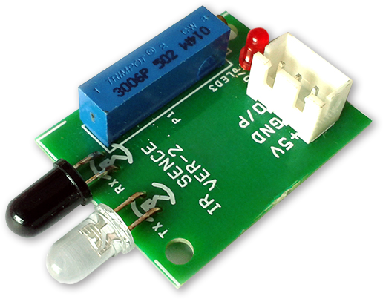
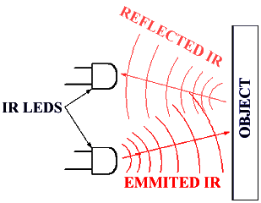
A passive infrared sensor (PIR sensor) is an electronic sensor that measures infrared (IR) light radiating from objects in its field of view. They are most often used in PIR-based motion detectors.
PRINCIPLE
IR SENSORS:

Slide 7
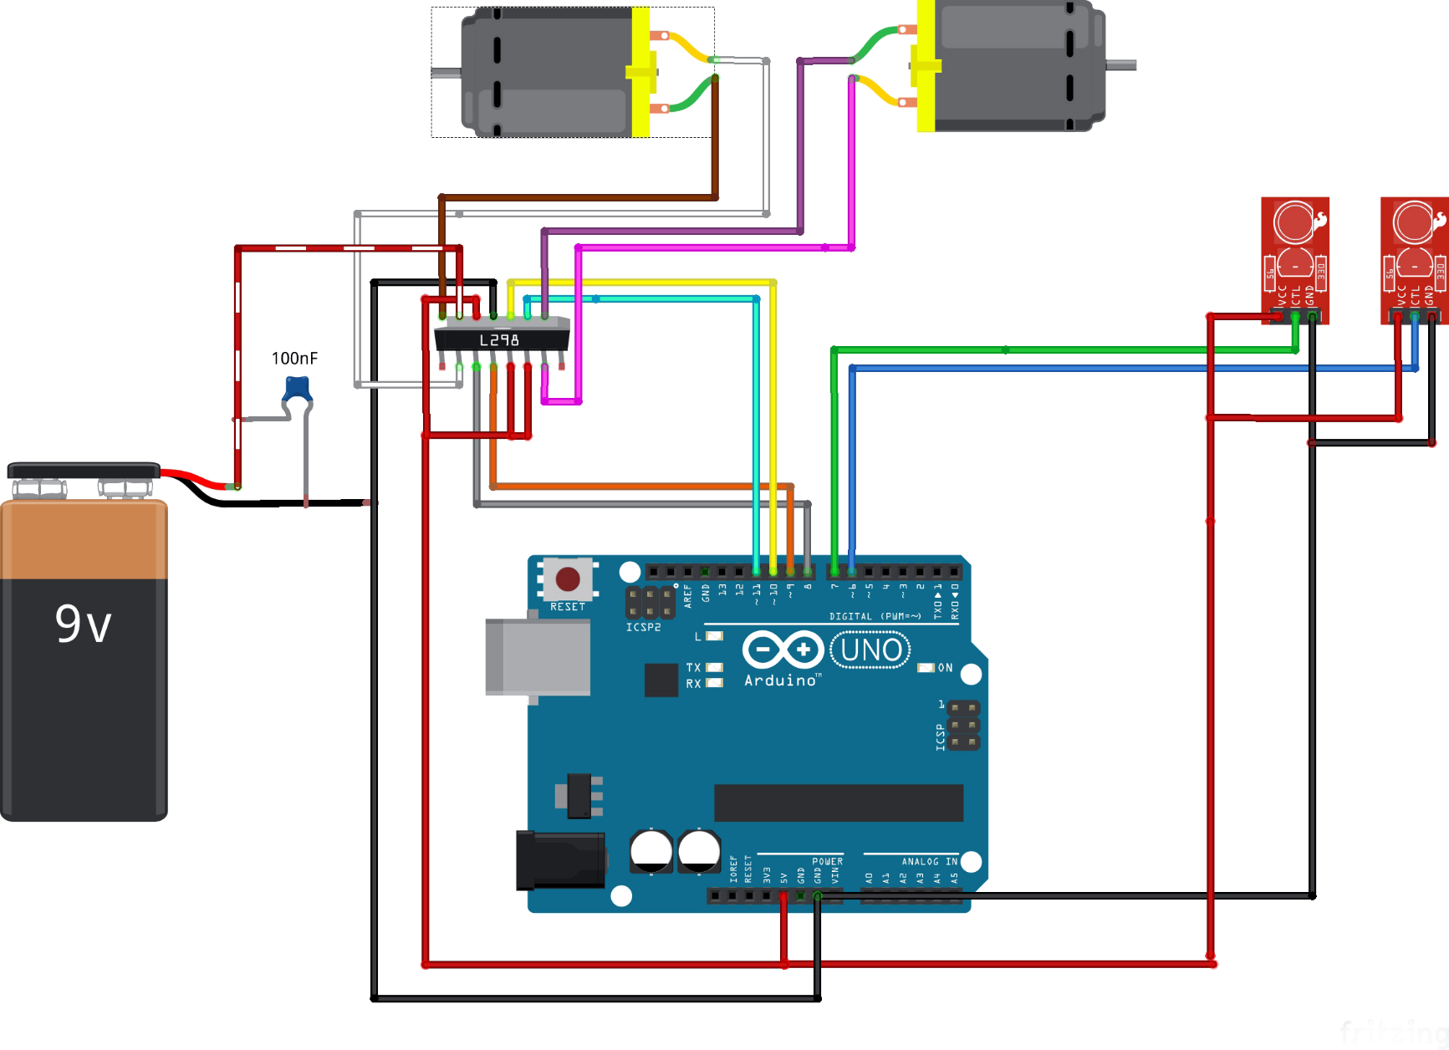
CIRCUIT DIAGRAM
CONNECTIONS

Slide 8
#define left_motor1 8 #define left_motor2 9 #define right_motor1 10 #define right_motor2 11 void setup() { Serial.begin(9600); } void loop() { int a = analogRead(A0); //Left Sensor int b = analogRead(A1); //Middle Sensor int c = analogRead(A2); //Right Sensor if(a<650 && b>650 && c<650) //Bot goes to forword { analogWrite(left_motor1,0); analogWrite(left_motor2,100); analogWrite(right_motor1,0); analogWrite(right_motor2,100); } if(a>650 && b<650 && c<650) //Bot turn to right { analogWrite(left_motor1,0); analogWrite(left_motor2,100); analogWrite(right_motor1,0); analogWrite(right_motor2,0); } if(a<650 && b<650 && c>650) //Bot turn to left { analogWrite(left_motor1,0); analogWrite(left_motor2,0); analogWrite(right_motor1,0); analogWrite(right_motor2,100); } if(a>650 && b>650 && c>650) //Bot turn off { analogWrite(left_motor1,0); analogWrite(left_motor2,0); analogWrite(right_motor1,0); analogWrite(right_motor2,0); } }
ARDUINO CODE:
COADING

Slide 9
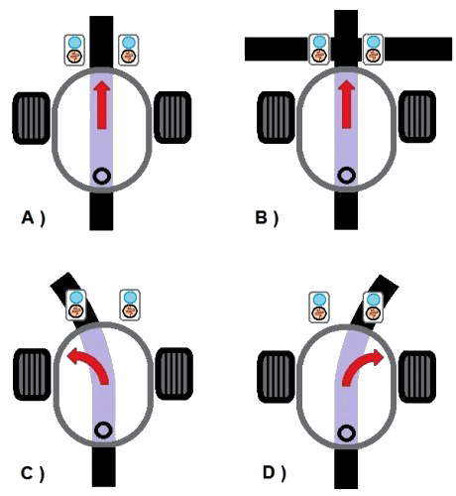
A) When both left and right sensor are sensing white, means black line is in between and bot goes forward. B) When both sensor are sensing black then robot will be stopped. C) When Left sensor senses black means a left turn. Turn off the left motor so that it turns left. D) When Right sensor senses black means a Right Turn. Turn off the Right Motor so that it turns Right until Right Sensor senses white again.
CONCEPT
LINE-FOLLOWING CONCEPT

Slide 10
► Industrial Applications: These robots can be used as automated equipment carriers in industries replacing traditional conveyer belts. ► Automobile applications: These robots can also be used as automatic cars running on roads with embedded magnets. ► Domestic applications: These can also be used at homes for domestic purposes like floor cleaning etc. ► Guidance applications: These can be used in public places like shopping malls, museums etc. to provide path guidance.
APPLICAIONS
APPLICATIONS OF LINE FOLLOWER

Slide 11
Thank
You
!

